Slide 1
CHOOSING A RESORT TO STAY

Slide 2
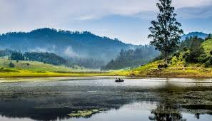
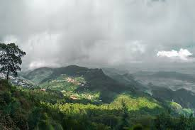
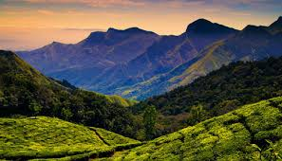
Kodaikanal is a hill town in the southern Indian state named Tamil Nadu. It’s set in an area of granite cliffs, forested valleys, lakes, waterfalls and grassy hills making it a tourist choice with its scenic beauty. Since there are lots of resorts in Kodaikanal, we will try to detect locations that are optimal for travelers with various interests. Some tourists may like resorts closer to the town, some may like resorts closer to tourist spots and so on. We will provide the details of each location so the tourist can choose the resort of their choice.
In this project we will try to find an optimal resort of a tourist choice in a tourist place named Kodaikanal, TamilNadu in India

Slide 3
EXTRACTING DATA FOR ANALYSIS
Following data sources will be needed to extract/generate the required information:
Resorts in Kodaikanal are obtained using Foursquare API
The details of the resort like the Rating, Number of Likes are obtained using Foursquare premium API
Number of restaurants, tourist spots and their type and location near every Resort around 2.5 km radius will be obtained using Foursquare API

Slide 4
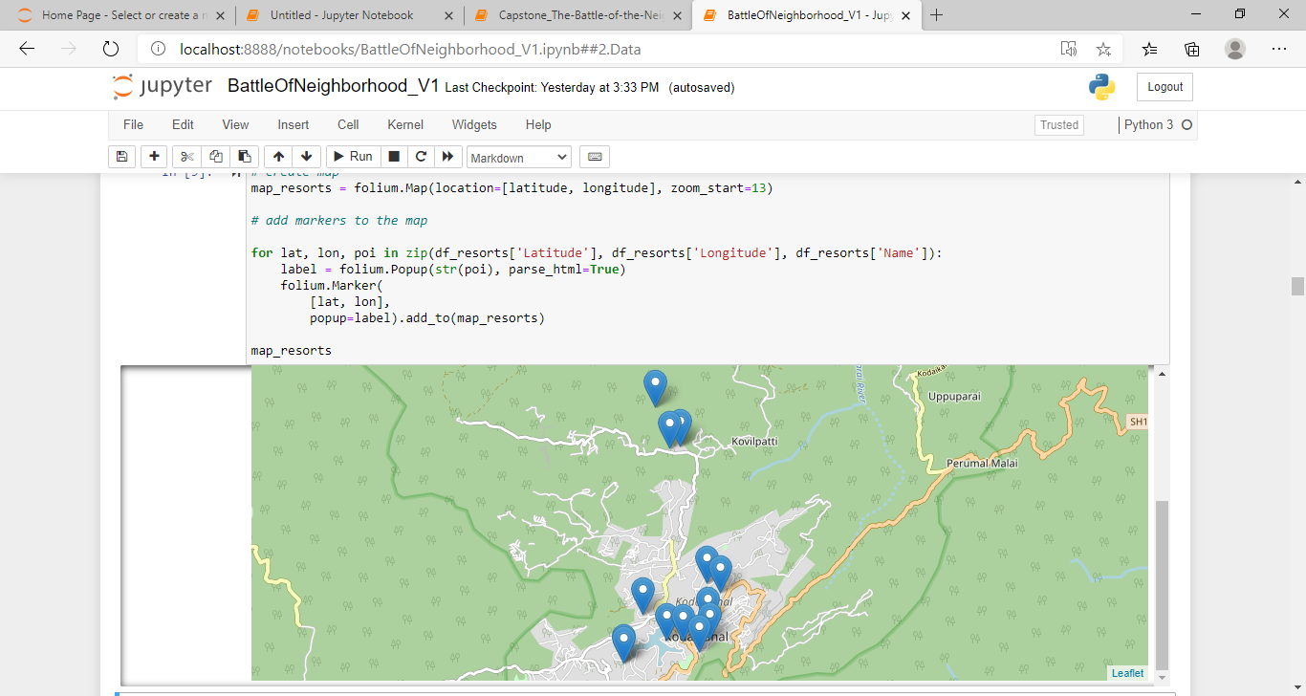
RESORTS TAKEN FOR STUDY
Carlton Hotel
The Kodaikanal Club
Hotel Kodai International
Apple Valley Resort
Hotel Cliffton
Villa Retreat
Hotel Vel's Court
Sterling valley view resort
Sterling Holidays, Kodai - Valley View
GRT Nature Trails. Kodaikanal
Le Poshe by Sparsa
Hill Country, Kodaikanal
Sterling Holidays, Kodai - By The Lake
Sterling's Kodai By The Lake Resort

Slide 5
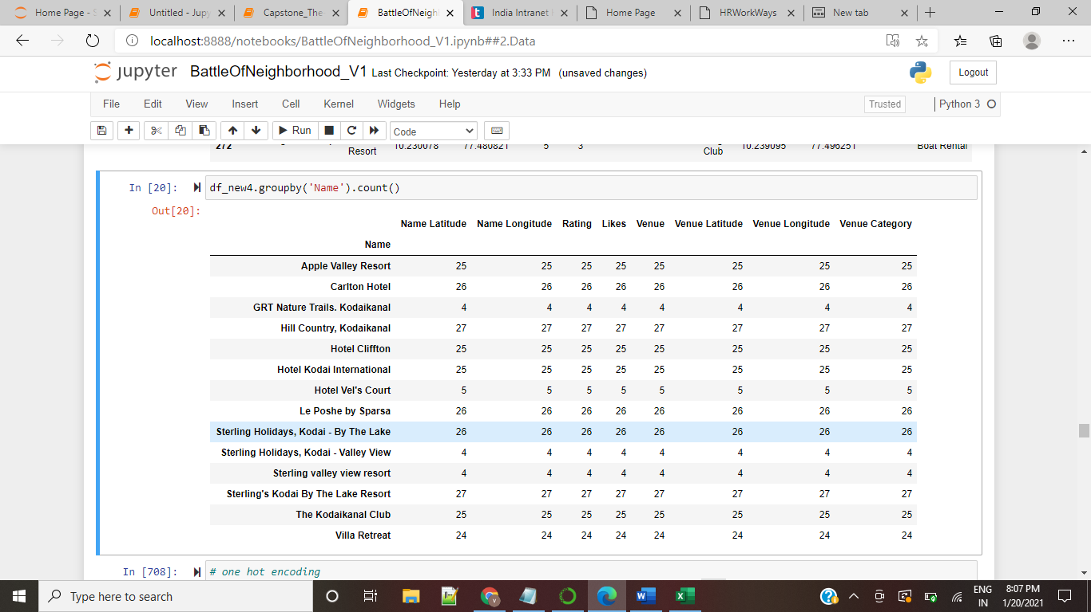
ANALYSIS
The factors that will influence our decision are:
Venues Close by the resort – Venues could be shopping areas, other tourist spots, forest
Ratings on the Resort – Ratings given to the resort by others and available in Foursquare
Likes on the Resort – Number of likes on the Resort given by other visitors of the Resort and available in Foursquare

Slide 6
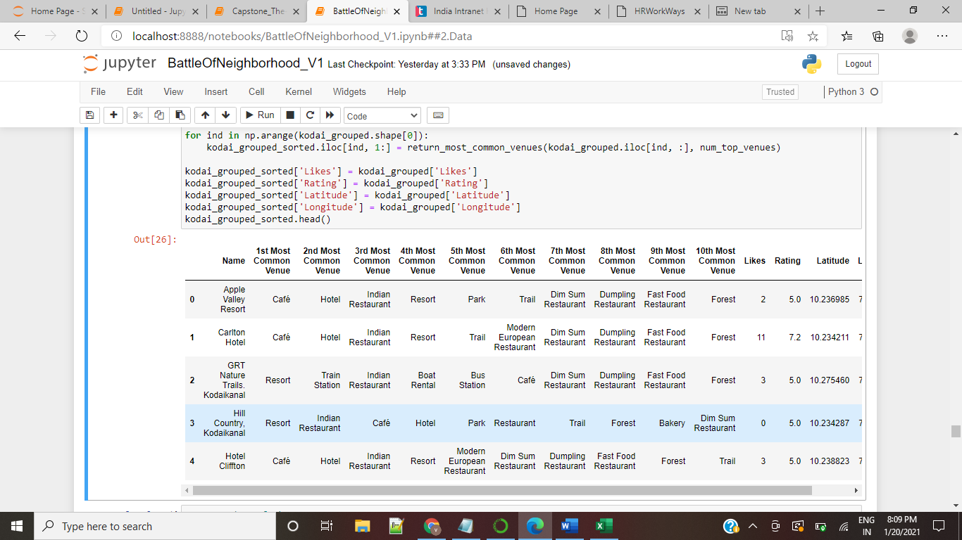
CLUSTERING
The below table shows the resorts with the 10 top most venues used by the visitors around the resorts. The data along with the Rating and Likes on the Resorts helps us to group the resorts of similarity in a cluster using the K-Means clustering algorithm

Slide 7
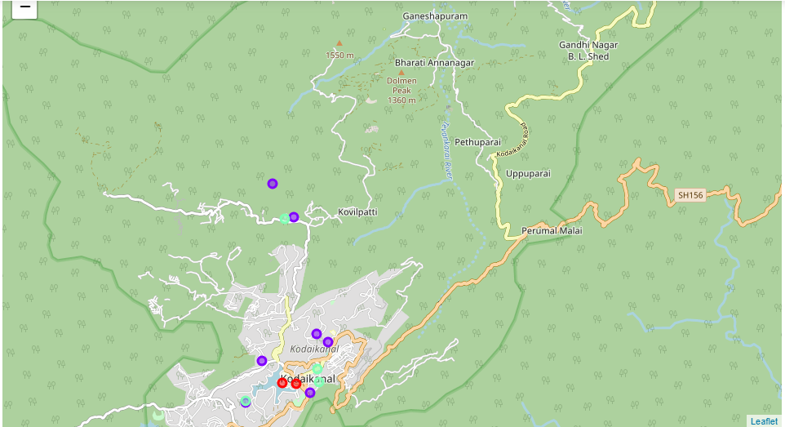
MAP SHOWING RESORTS BELONGING TO CLUSTERS
Cluster 0
Cluster 1
Cluster 2

Slide 8
Results and Discussion
Based on the clustering results we have the following observation
Cluster 0 - Has resorts that has number of likes greater than 5 and rating greater than 5 and few restaurants nearby. We have 2 resorts in this cluster 0
Cluster1 - Has resorts that has number of likes lesser than 5 and greater than 3 with a mix of nearby venues like park, boat rental, restaurants and forest. We have 7 resorts in this cluster.
Cluster 2 - Has resorts that has number of likes lesser than 5 with a mix of nearby venues like park, boat rental, restaurants and forest. we have 5 resorts in this cluster

Slide 9
Conclusion
Tourists who like to be in resorts with greater number of likes and that are not close to any other tourist venues can choose a resort from cluster 0. Tourists who like to be in resorts near to tourist venues with greater number of likes can choose a resort in cluster 1 and Tourists who likes to be in resorts near to tourist venues and does not worry about number of likes can choose a resort in cluster 2.
We can also include pricing details and the cuisine of the Resorts to determine the cluster groups. These details were not available for these Resorts in FourSquare and hence were not included.

